Slide 1
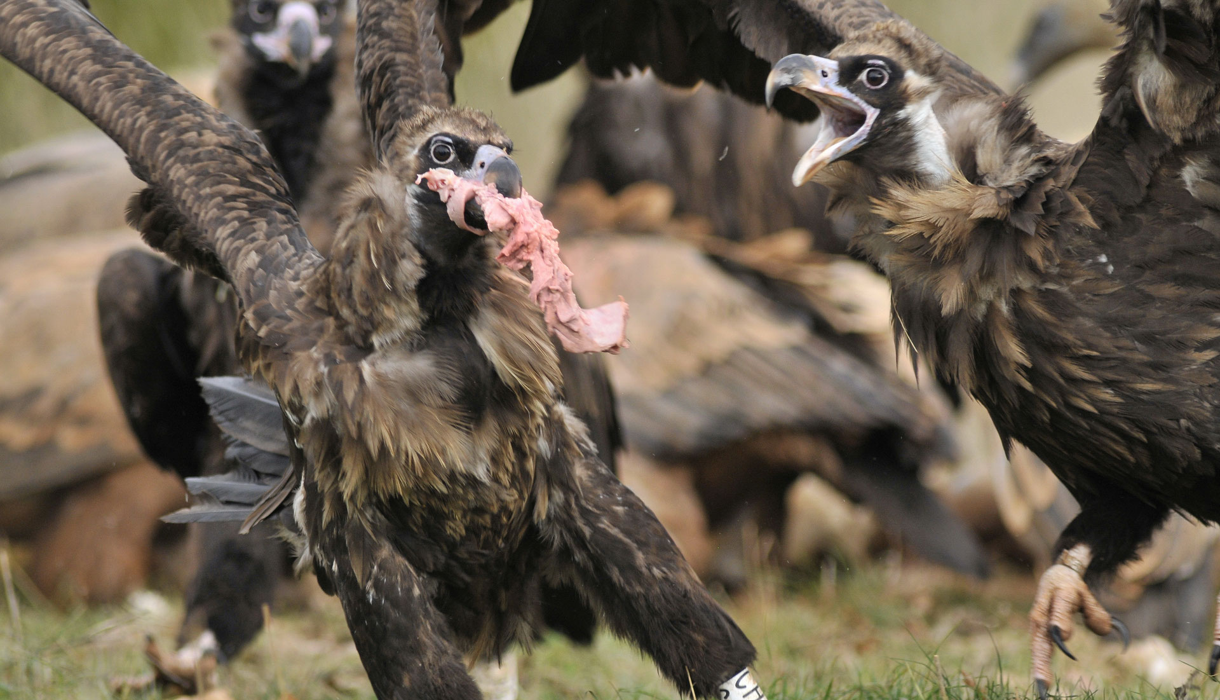
Species identification and intraspecific genetic diversity for the vulture

Slide 2

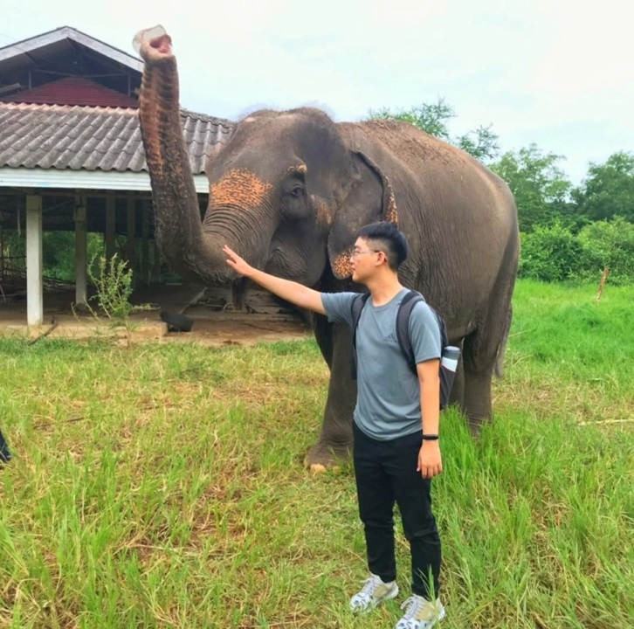

OUR VULTURE TEAM
Annie
Kevin
Dr.Pai

Slide 3
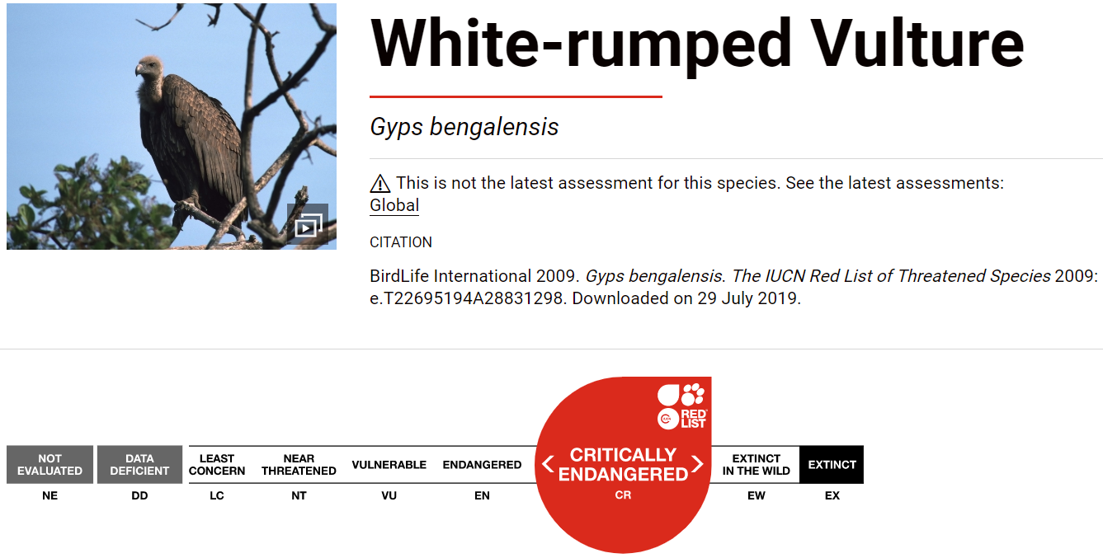
Vultures are endangered species
Notes:
IUCN

Slide 4
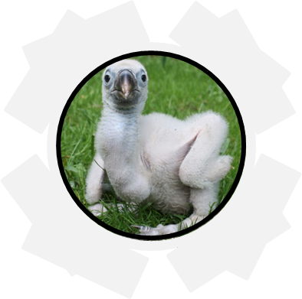




Future declines of vulture population are possible
Vulture is scavengers that feeds on dead animals
rodenticide, polution, declofenac, and poaching may damage the vulture population
Genetic, management and camera track may help us learn more about the vultures
Notes:
Three things damage the vulture population: rodenticide, polution, declofenac, poaching
Genetic management ,camera
Track to vulture, iucn
12s,coI
Tree: method
Objective before result

Slide 5
Q 1. Evaluate efficiency of barcoding primer Q 2. Assess intraspecific genetic diversity

Slide 6

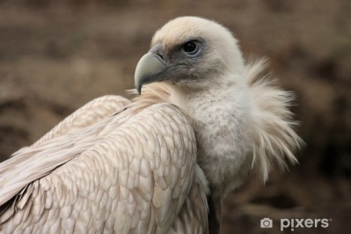
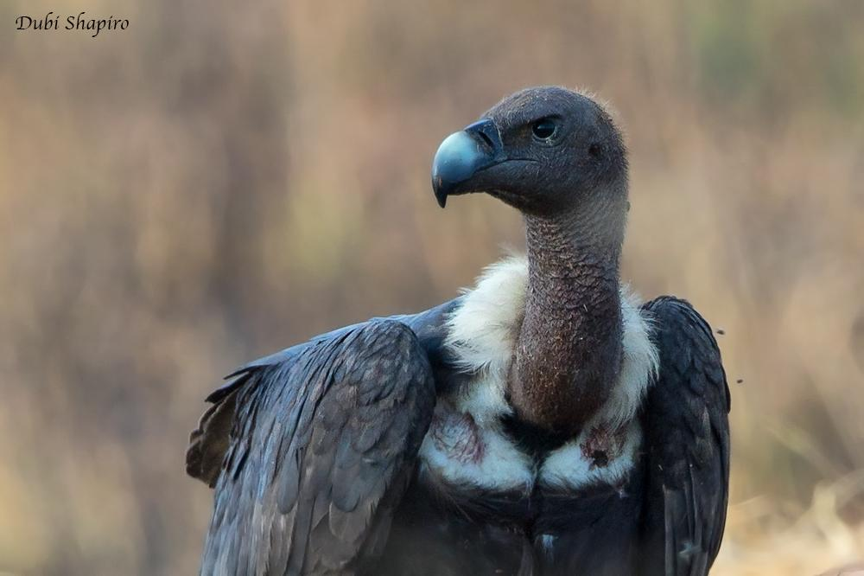
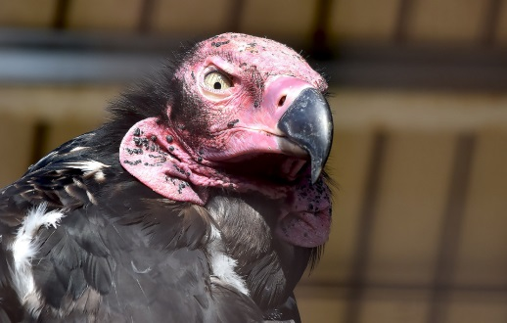
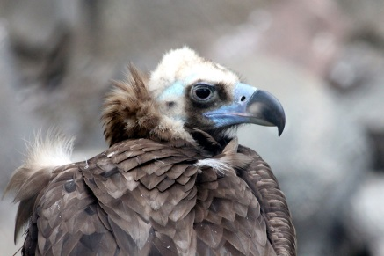
The four species of the vulture to analyze
8 samples
Gyps himalayensis
Gyps bengalensis
Sarcogyps calvus
Aegypius monachus
Notes:
We got 8 sample, and were told to analyze the species
The four species : Gyps himalayensis, Gyps fulvus, Sarcogyps calvus, Aegypius monachus

Slide 7
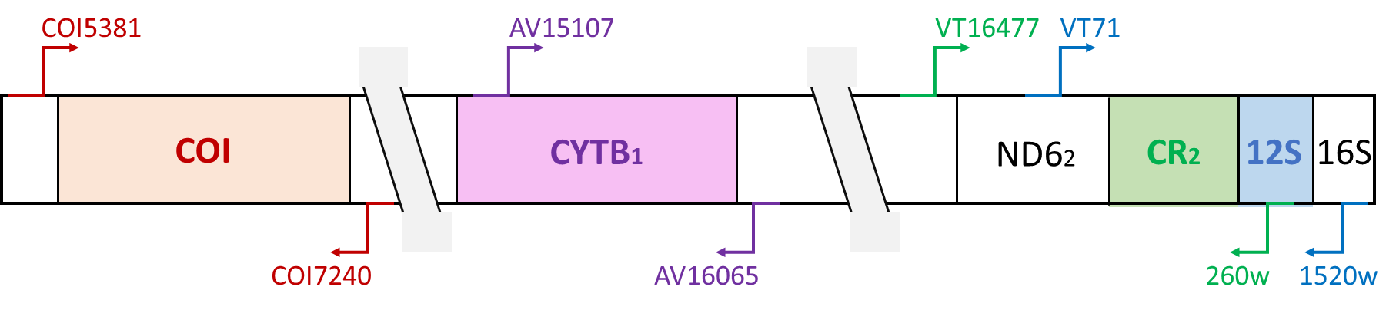
Barcoding primers can differentiate a species from others
12S and COI region are the conserved region in the vulture
They are protein coding gene with slower mutation rates compared to non-protein coding region like Control region(CR)
Notes:
Q1: Evaluate the efficiency of barcoding primers to differentiate species.
(12s and COI region)
Q2: Analyze intraspecific genetic diversity.
(CYTB1 and CR region)

Slide 8
Q 1. Evaluate efficiency of barcoding primer

Slide 9
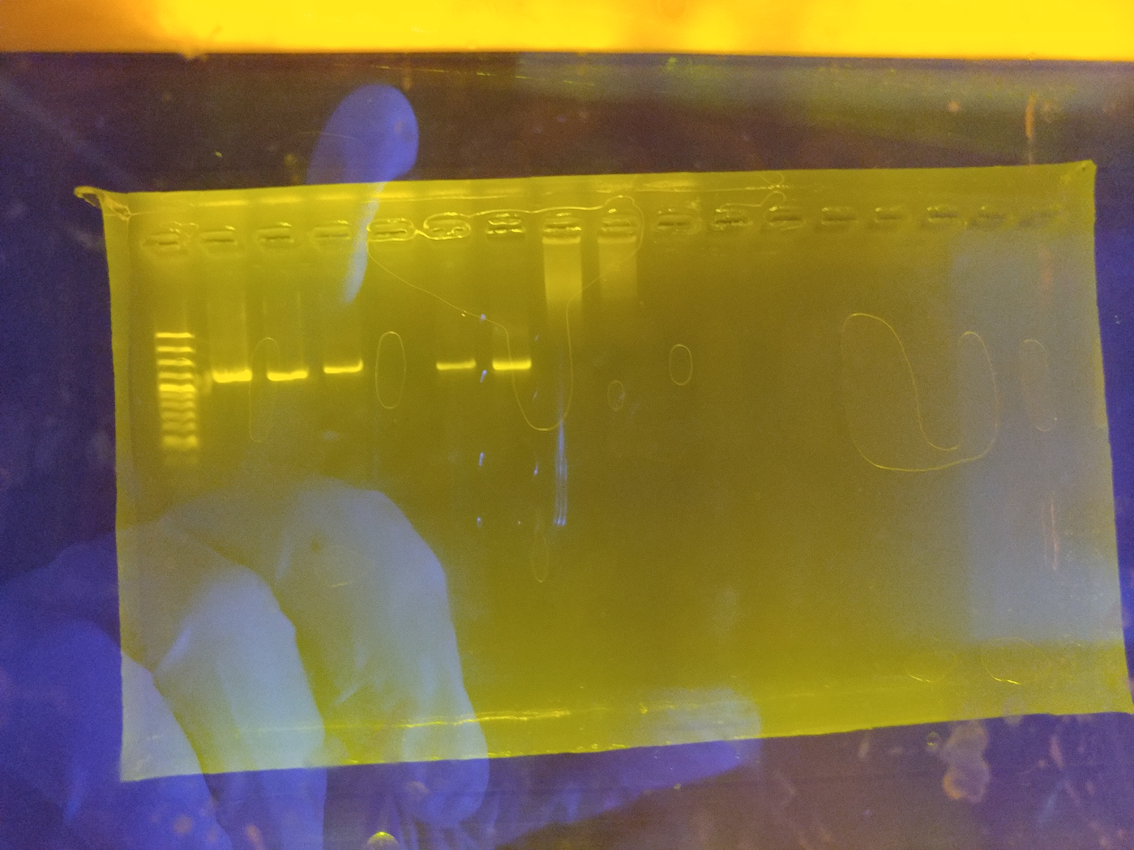
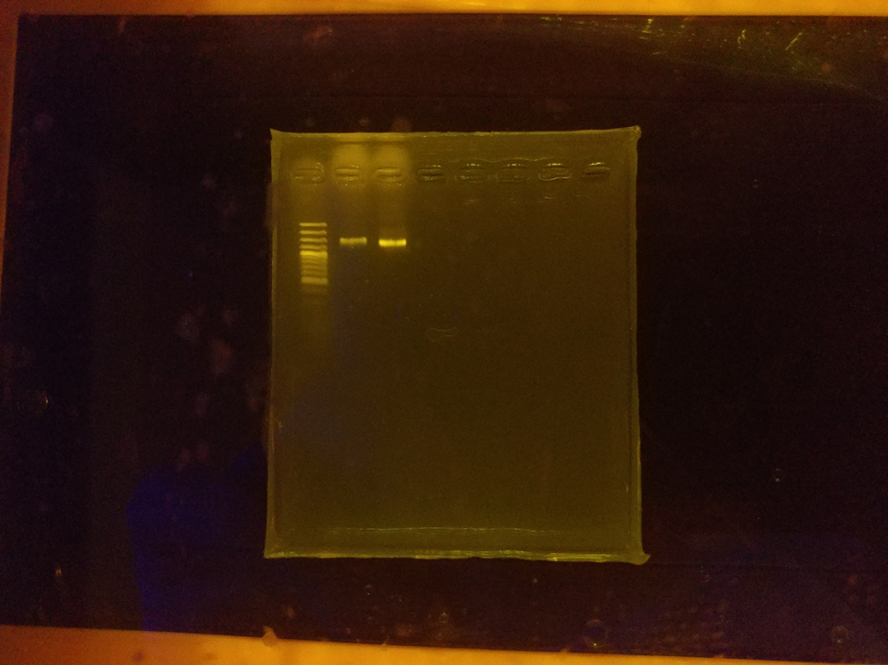
Success to get 12S region DNA fragment from the sample
We successfully get Vt1, Vt2, Vt5, Vt6, Vt7, Vt13, Vt18
M Vt1 Vt2 Vt5 Vt6 Vt7 Vt13 Vt17 Vt18 NC
M Vt6 Vt18 NC
Primer: VT71/1520w
Region: CR2 /12S/16S
Size: 1.5k bps
Polymerase: Taq
Primer: VT71/1520w
Region: CR2 /12S/16S
Size: 1.5k bps
Polymerase: direct-green
Notes:
Show the gel picture → success/fail to get DNA fragment
Primer vt16477_260w fail at the first, so we change the polymerase(direct-green)
Primer vt16477_260w is not good for alignment
補膠圖 要有NC

Slide 10
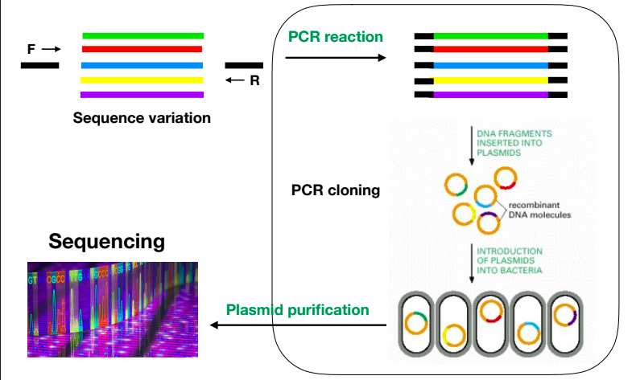
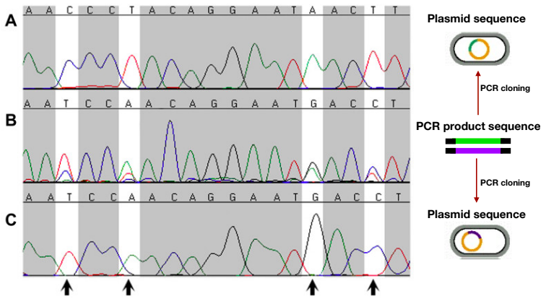
Cloning PCR can solve the multiple signal in 12S region
Multiple peaks
Single peak
Notes:
Explain the reason there are multiple signal in the sequencing result (DNA variation in S12 region?). Numts, multiple infectious, or psudogenes
Explain how cloning PCR can solve the problem
separate the signal by
Cloning procedure – plasmid extraction

Slide 11
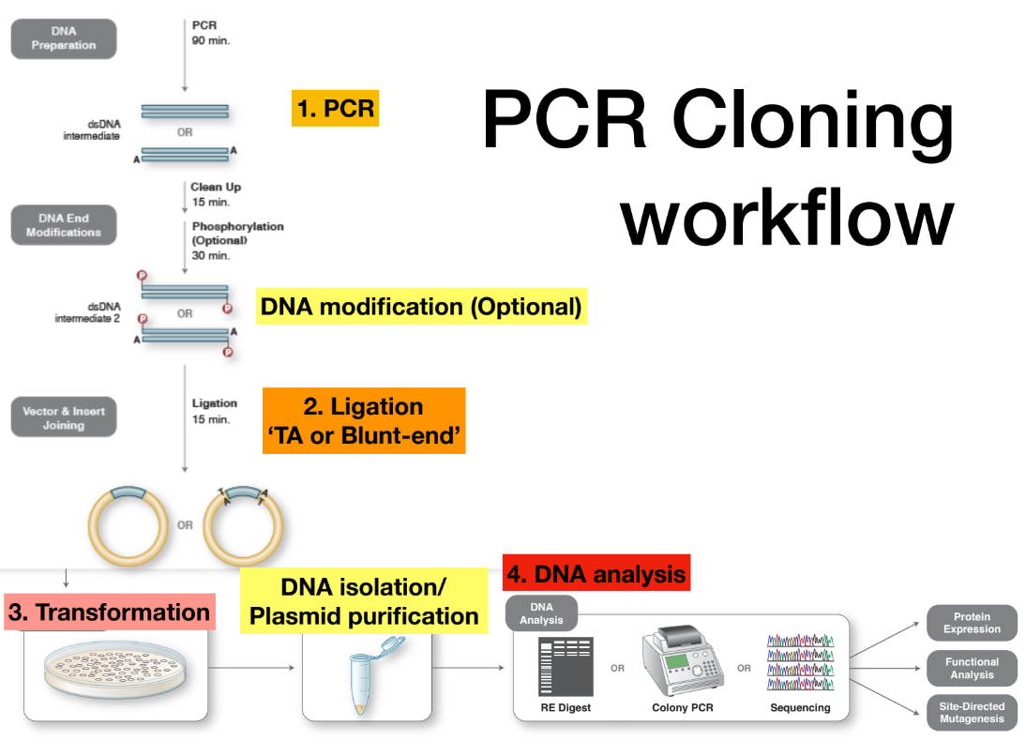
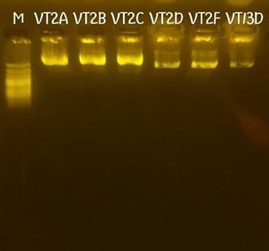
Get purified DNA fragment by cloning PCR and extraction
Cloning PCR are successful with VT2A, VT2B, VT2C, VT2D, VT2F, VT13D
Primer: pJET_1_2F/2R

Slide 12
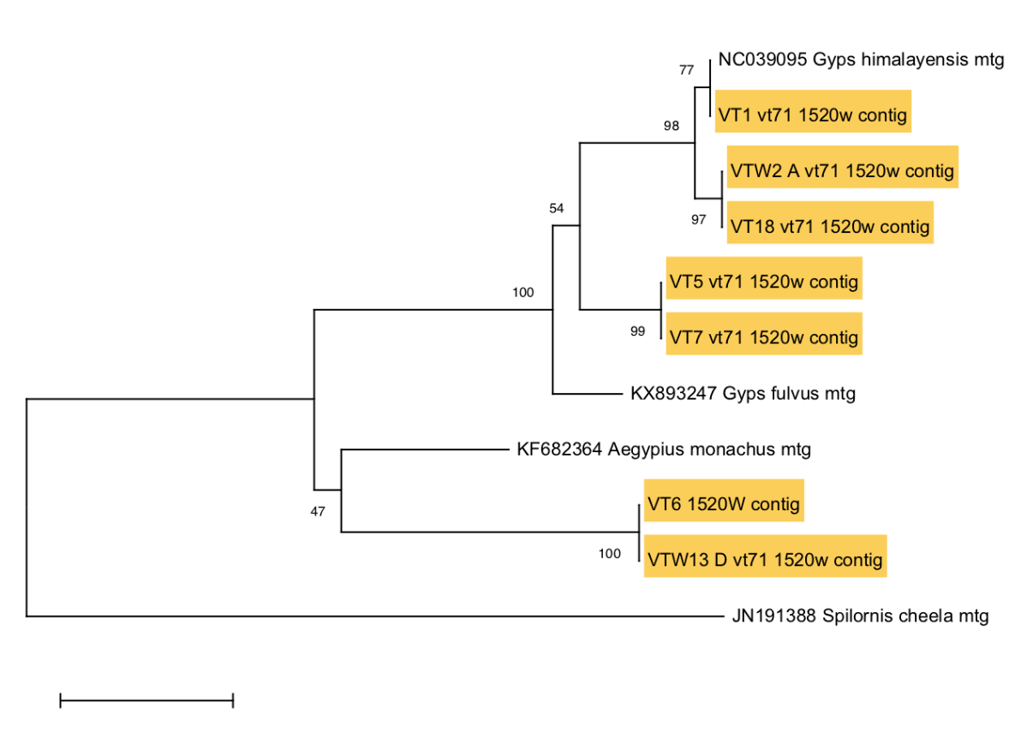
Phylogenetic tree based on 12S
12S
Gyps himalayensis
VT1/VT2/VT18
Not confirmed
→VT5/VT7
→VT6/VT13

Slide 13
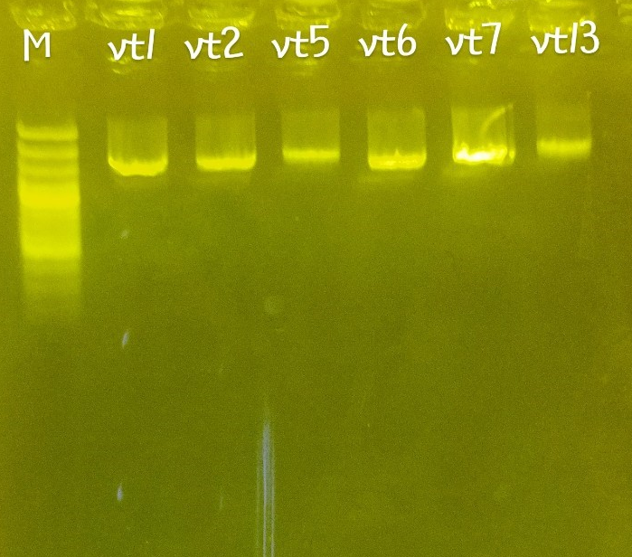
Differentiate the species by COI primer
Success to get DNA fragment from VT1, VT2, VT5, VT6, VT7, VT13 by COI primer
There are more data about COI region than 12S region on NCBI
Primer: COI5381/7240
Region: COI
Size: 1.8k bps

Slide 14
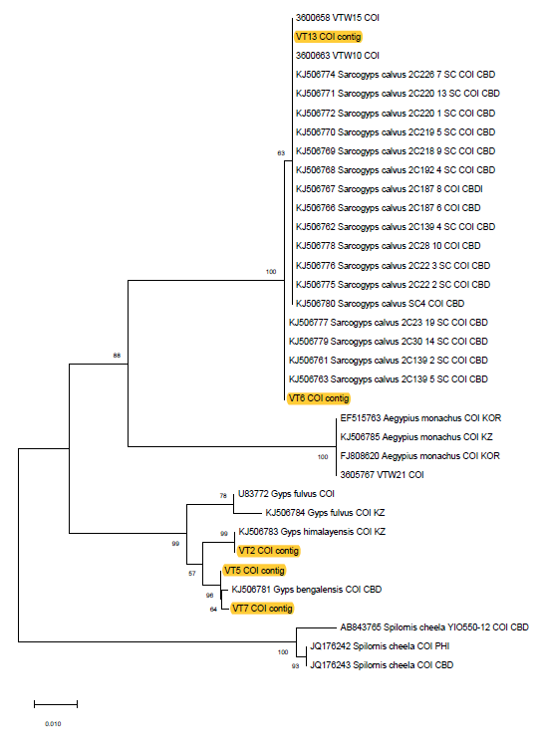
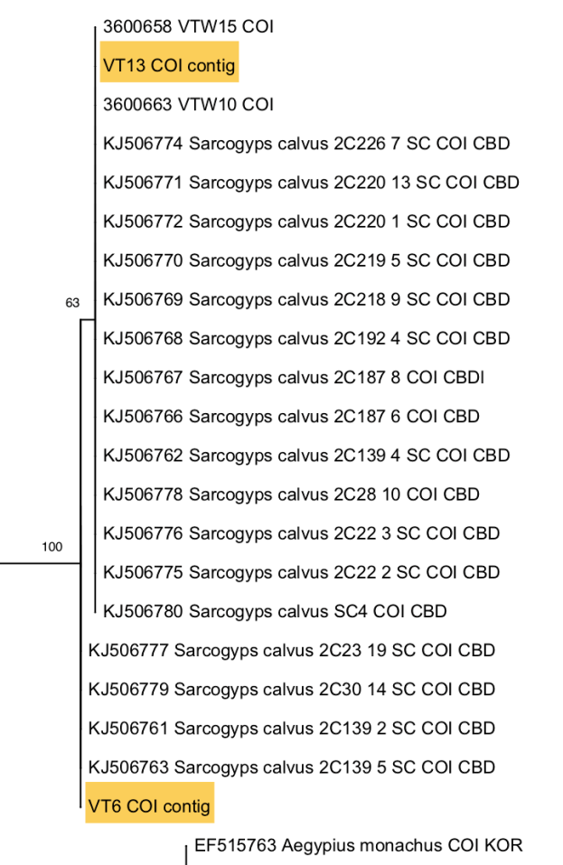
Phylogenetic tree based on COI
COI
Sarcogyps calvus
VT6/VT13
Cambodia
2 clades

Slide 15
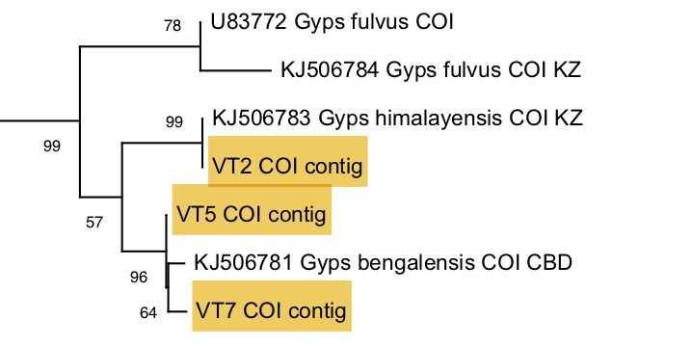
Phylogenetic tree based on COI
COI
Gyps Bengalensis
VT5/VT7
Cambodia
2 clades
Gyps himalayensis
VT2
Kazakhstan

Slide 16
Q 2. Assess intraspecific genetic diversity

Slide 17
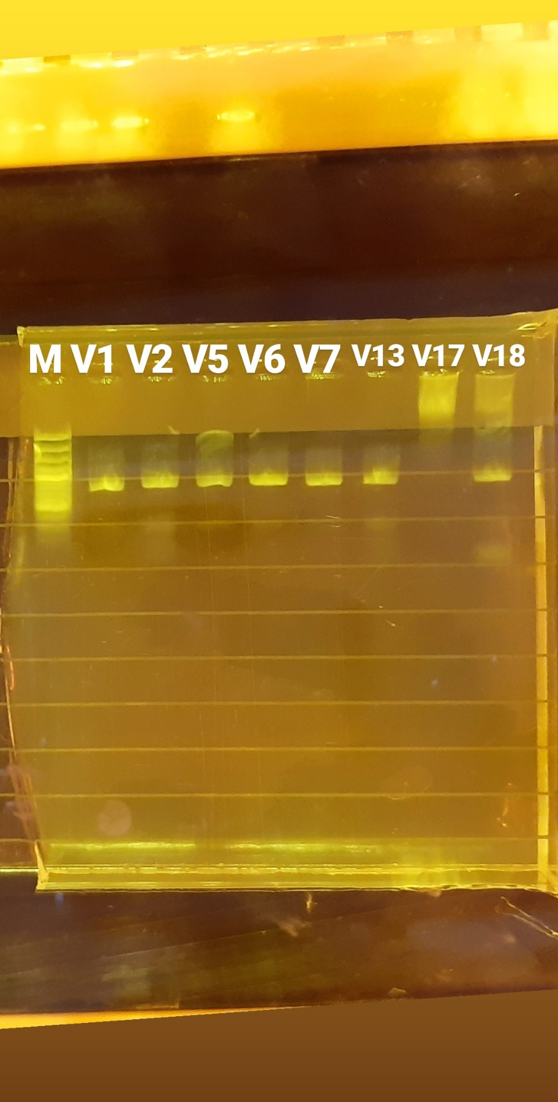
Intraspecific diversity based on CYTB1
Success to get CytB fragment from VT1, VT5, VT6, VT7, VT13, VT18 by primer AV15107/16065
CytB has higher mutation rate than 12S or COI region, so it can show intraspecific diversity
Primer: AV15107/16065
Region: CYTB1
Size: 900 bps

Slide 18
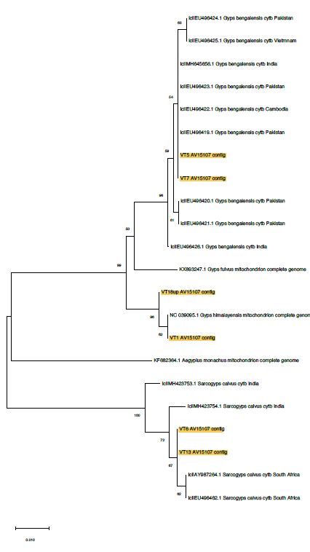
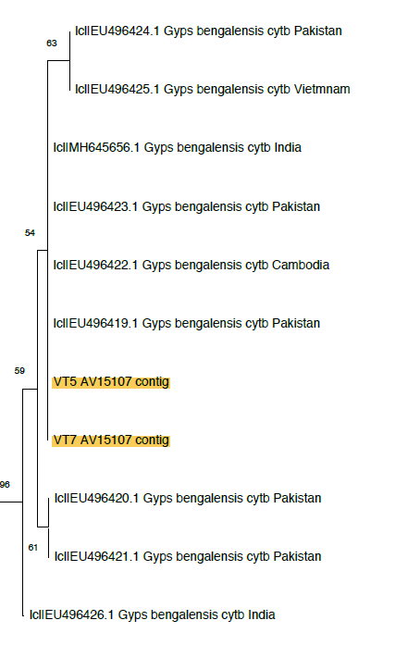
Phylogenetic tree based on CYTB1
CYTB1
Gyps bengalensis
4 clades
CYTB1>COI clades
Notes:
Analyze
Show tree
Result

Slide 19
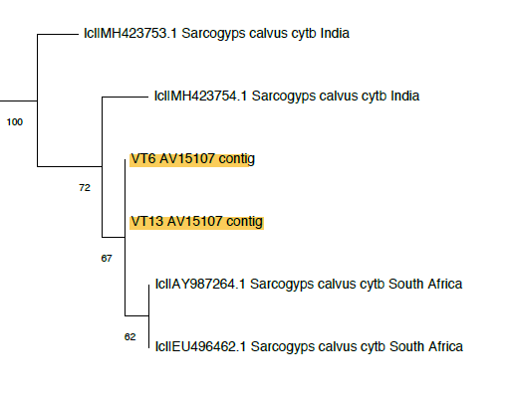
Phylogenetic tree based on CYTB1
CYTB1
Sarcogyps calvus → 4 clades
CYTB > COI clades
→ CYTB is high mutation
→ High genetic diversity
Notes:
Analyze
Show tree
Result

Slide 20
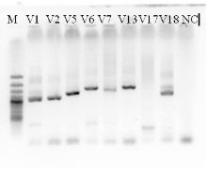
Intraspecific diversity based on Control Region
Success to get CR2 fragment from VT1, VT2, VT5, VT6, VT7, VT13, VT18 by primer VT16477w/260w
There are two CR region in the vulture genome, the data on NCBI might be CR1 but not CR2
Primer: VT16477w/260w
Region: CR2 /12S
Size: 1.5k bps

Slide 21
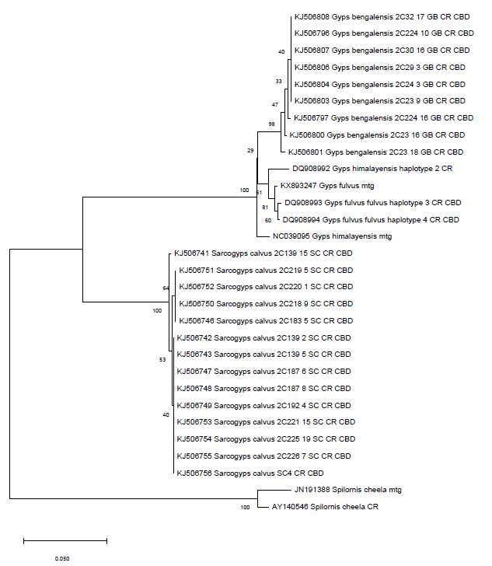
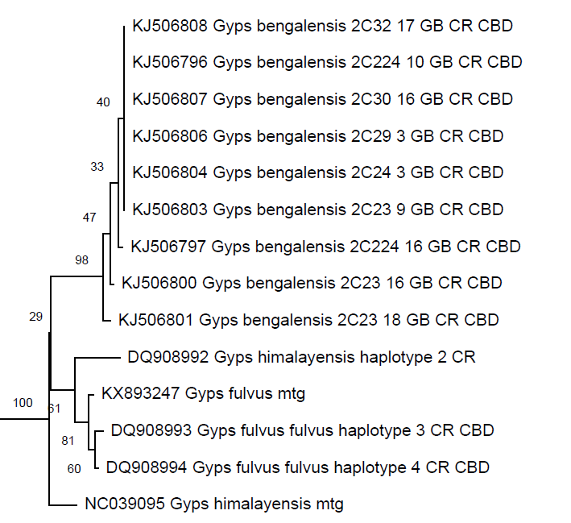
Phylogenetic tree based on CR
Gyps bengalensis → 4 clades
Sarcogyps calvus → 3 clades
CYTB1 and CR → high genetic diversity
CR1
Notes:
Analyze
Show tree
Result

Slide 22
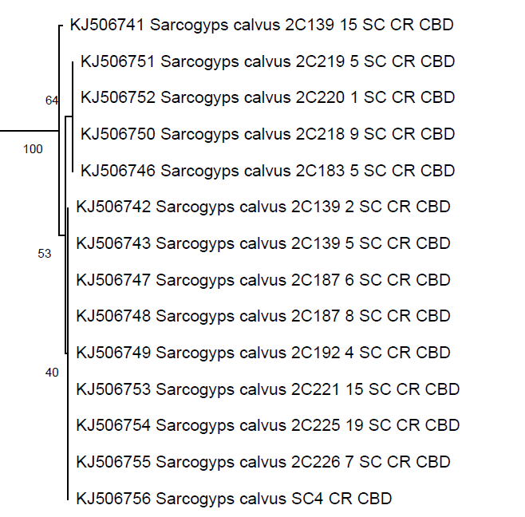
Phylogenetic tree based on CR
Gyps bengalensis → 4 clades
Sarcogyps calvus → 3 clades
CYTB1 and CR → high genetic diversity
CR1
Notes:
Analyze
Show tree
Result

Slide 23




Indentification of the vulture
VT1
VT2
VT18
VT5
VT7
VT6
VT13
None
Gyps himalayensis
Gyps bengalensis
Sarcogyps calvus
Aegypius monachus

Slide 24
Discussion
COI is good barcoding primer because there are a lot of data with COI region in the genebank
VT16477/260w primer are bad for barcoding because of the difficulty for alignment
We suggest that DNA of VT17 have been degraded because no band can be get by using four primers
We will be the first one to upload 12S region of Gyps bengalensis

Slide 25
Future work
Identification of sample VT17 with different primer
Confirm the geographic region of each sample

